Slide 1
Adverse Childhood Experiences
Craig C. Corp, MD
Notes:
For Summit:
thank you for the kind introduction Quinn, thanks to all of you for being here today.
Whenever I see a group, like this, of people interested in learning about childhood trauma and toxic stress, and excited about the possibility of reducing it for the children of this nation, it gives me a great deal of hope. What a wonderful world it would be if all children could grow up in an environment in which they don’t feel that they have to fight to survive.
I think we have an excellent day lined up. I very much hope that each and everyone of you learns a few things that will help you in your daily practice when identifying, helping to prevent and resolve the causes of adverse childhood experiences, and in treating their short and long-term consequences
I think we have people here today with a wide variety of knowledge regarding ACEs. I want to start the day out by making sure we are up to speed. So, I am going to give an introduction to ACEs. I hope that even ACEs veterans will hear something new or be challenged to think about things a bit differently than they have.

Slide 2
Notes:
As I’m sure most of you know. California rolled out the ACEs Aware program 3 years ago. In doing so, it became the first state in the nation to encourage all 60+ of its counties to form trauma informed networks of care. It has set the truly audacious goal of reducing ACEs by 50% in 10 years. The state has, fortunately, been putting it’s money where its mouth is and has given out grants yearly from 3 million in planning grants three years ago to 19.5 million to screen and respond for next year
SCMF, which is the foundation that supports both PNCMS and SYCMS obtained funding from Sutter Health both last year and this year, and, fingers crossed, next year as well. We also appreciate a grant from Kaiser Permanente for this event. With that we have been focusing on creating relationships within, initially, Placer County, as well as learning about and educating our partner organizations. Our current coalition members list is huge and includes, amongst others, Sutter Health, Kaiser Permanente, Tahoe Forest, PeachtreeHealth, Chapa De, American Academy of Pediatrics, First 5 coalition, Anthem Blue Cross, several groups of psychologists, student health alliance, law-enforcement, parole, judiciary, employment, housing, and food banks, (sorry if I left anyone out, it’s a long list). Our eventual goal is to eventually stand up a trauma informed network of care in Placer County.
So, what does that mean. We are trying to build what we think is the best model for a TINC. Currently: there are resources online where anyone can find out information for themselves or someone who they’re trying to help with social and medical services by ZIP Code. Probably the best one currently is findhelp.org which until recently was called auntbertha.org. But they have to call and do everything’s themselves. The state also has the volunteer staffed 211 phone system where volunteers can help people by giving them contact numbers for services similarly to looking on findhelp.org. What we are hoping to do, however, is to set up a “one stop shopping“ system where someone could refer a family in need of assistance to us and people trained and qualified to do so can participate in helping them meet all of the often complex needs of their family, follow through to make sure that they are getting the services they need, help provide interagency coordination and information sharing as needed between otganizatins as well as get updates to the referring provider.

Slide 3
Why it matters
Notes:
So, what can we all do to help?

Slide 4
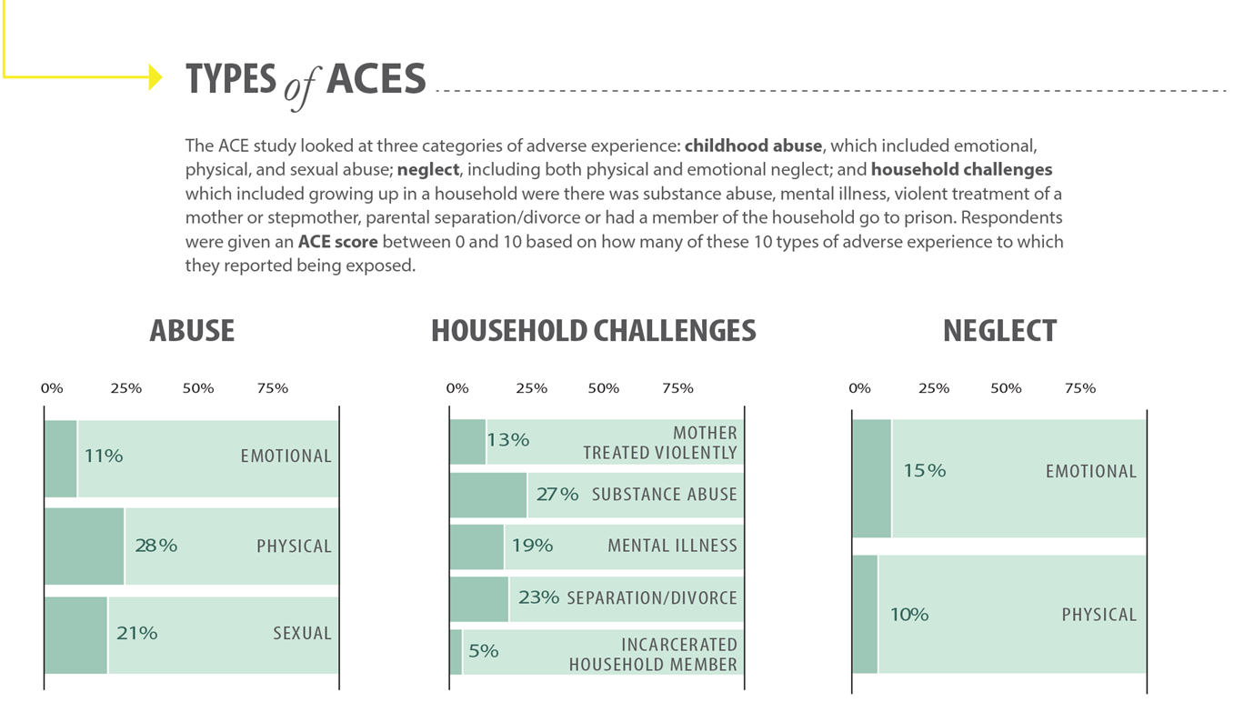
Primary ACEs (PEARLS pt. 1)
Notes:
4 or more of these is considered to be toxic briefly cover them.
PEARLS has two parts.. PEARLS asks about the 10 main ACEs part one. Part two is somewhat optional, but I think that there is a lot of utility to it myself. There is a part two that asks seven additional questions. These include being exposed to violence in the neighborhood, community, or school. Experiencing discrimination. Having had problems with housing. Having experienced food insecurity. Having been put in foster care or separated from their parents because of immigration. Having a parent with a serious physical illness, or disability. And, finally, having lived with a parent or caregiver who died.

Slide 5
Additional ACEs (PEARLS pt. 2)
Being exposed to violence in the neighborhood, community, or school
Experiencing discrimination
Having had problems with housing
Having experienced food insecurity
Having been put in foster care or separated from their parents because of immigration
Having a parent with a serious physical illness, or disability
Having lived with a parent or caregiver who died
Notes:
Highlight maybe three of these

Slide 6
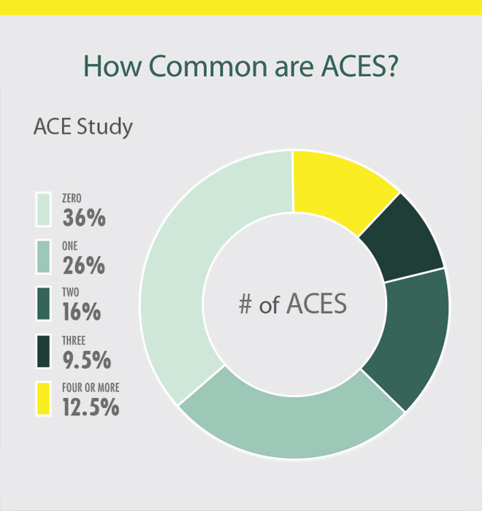
How Common Are They?
Notes:
Kaiser study in CA – over 60% with at least one, 19% with 4 or more, higher in certain populations
1:8 children will be abused by age 18
40% of foster children have at least one parent addicted to alcohol or drugs
US – 41 million people with 4 or more
In fact, it is estimated that the overall cost of cases to the United States is around $1.2 trillion a year, about $120 billion a year just for state of California.
Who has toxic stress in childhood: by far the predominant factor is poverty. Interestingly, ethnicity is less of a factor than anticipated, sexual minorities - LGBTQIA

Slide 7
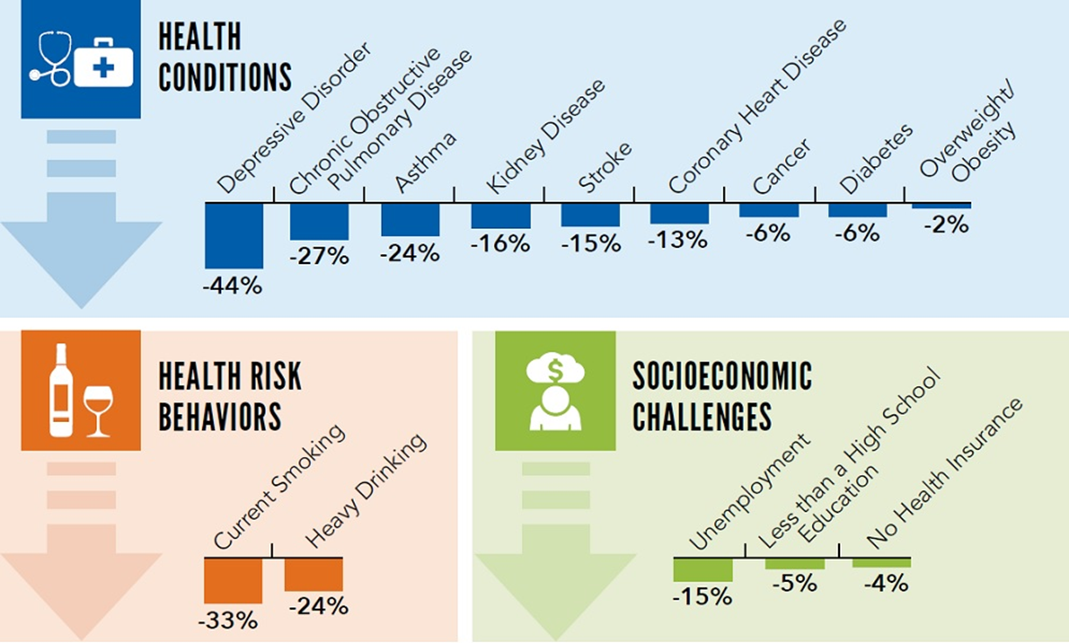
What it Leads To
Notes:
This slide lists, some of the most common long-term effects of toxic stress in childhood. As you will not, includes five of the 10 leading causes of morbidity and mortality the United States today
I like to think of these, not as something that needs to be memorized, but, rather, as something that one can predict with a simple thought experiment. We are mammals, and we are built to adapt to our environment, especially as we are growing up in it. If the environment is unsafe, and we don’t really know if we could be hurt or even die from being in that environment, our bodies undergo drastic changes in order to adapt. Those are primarily caused by epigenetic changes that alter whether or not ,and how much, a host of different genes are activated. Those changes directly affect brain development, our hormonal axes, the immune system, and many other things. It is possible to mitigate some of those changes if the individual is resilient, if not, often times these changes are lifelong.
So, think about it
STRESS
If you don’t know if you might be hurt – you get stuck in fight or flight mode and our stress hormones change to reflect that. You become hyper vigilant. You suffer from constant stress. Your attention is constantly looking at and listening to all the little things around you to see if there is anything dangerous there. So you wind up with ADHD, anxious a depressed. The long term changes in your stress hormones can cause you to develop hypertension as well.
NUTRITINO AND WEIGHT
If you’re not sure where your next meal is coming from, your body lowers its metabolism and gets better at storing fat. You also likely wind up living on an unhealthy diet of inexpensive food with low nutritional value. So, you wind up obese with secondary type 2 diabetes. That and/or stress linked hypertension leads to coronary artery disease and strokes.
Those who are unfortunate enough to live in a “food desert“ have such poor nutrition that it drastically changes their gut microbiome. That can lead to a state of nearly constant hunger. It can also lead to pretty much any type of mental illness because our gut flora communicate directly with our brain and pretty much all of the neurotransmitters or neurotransmitter precursors in our body are made by the bacteria in our gut. That level of poor nutrition can directly lead to a lot of the same long-term consequences that toxic stress levels of ACEs can. So children who are exposed to both have an even higher risk of long-term consequences.
Diabetes can lead to= kidney disease
LUNGS
It is not uncommon for children experiencing a lot of ACEs to be exposed to unhealthy air so they develop asthma. They are more likely to smoke, drink, heavily, or do drugs in order to try to relieve some of that stress since they have never developed or been taught tools to deal with life in a productive manner. Smoking can lead to COPD and alcohol or substance abuse disorder is a progressive, fatal illness if the individual cannot get clean and sober.
REPRODUCTION
If you’re uncertain if you will live to reproduce, you will develop sexually an earlier age because of changes in the sex hormone axis, you have an earlier sexual debut, and you likely have children at an early age.
GOALS
Finally, if you expect your life to be short, it makes it impossible to have long-term goals. That means that you likely place little meaning on going to school or getting and maintaining a job. So you wind up not completing high school, unemployed, with no health insurance which, of course, compounds all the other health issues.

Slide 8
Some striking numbers
ACE score of 6 or more reduces life expectancy by 20 years
Score of 4 or more: 3600% higher chance of IV drug use, 4600% if >6
1200% greater likelihood of suicide (2900% if >6)
1200% likelier to be sexually assaulted
700% likelier to become an alcoholic
400% likelier to have chronic bronchitis
300% likelier to catch HIV
300% likelier to have chronic depression
Notes:
Highlight maybe three of these

Slide 9
It Will Take a Village
Notes:
So, what can we all do to help?

Slide 10
Principle Sectors
Healthcare
Public Health
Social Services
Early Childhood
Education
Justice
Notes:
First off, understand that really addressing this is going to mean that many significant issues in society be addressed.
It will take, at a minimum, all of these sectors of society to be involved. Increasing the numbers of individuals trained to deal with childhood trauma in many different areas and running trauma informed networks of care is going to need funding. Hopefully the state and federal government as well as various philanthropic entities will continue to fund programs. I suspect that as the changes become more visible and more public education about ACEs is done, that it will start to get funding from the corporate world as well as a popular cause amongst their customers

Slide 11
Primary Prevention
Economic supports and family friendly work policies to address poverty and food insecurity
Access to high quality physical and mental healthcare to get well
Public education campaigns to raise awareness
Teach stress buffering activities (mindfulness, nature, physical activity and sufficient sleep) to relax
Give children the support they need to be resilient
Notes:
= So it doesn’t happen in the first place-need to address disparities
RESILIENCY
The most important factor in ACEs resiliency is having at least one adult in a child’s life who believes that they have a future ahead and who is willing to support them in fulfilling their goals. The absolute crucial thing, is that it has to be someone that the child believes will always be there for them going forward, because that relationship becomes the guiding relationship in their lives since they are not getting that support in their troubled home.
Additional resiliency factors include feeling loved by someone when little, especially if it is one or both parents Having someone to comfort them if they are feeling sad, or worried. Having a structured environment at home with rules and consequences makes a big difference. Feeling that others see them as capable and, having a positive personal outlook about the future.
There have been experimental classroom programs for grade school, teaching the children emotional intelligence, conflict resolution, communication skills, how to form long-term goals, and how to form intermediate steps to reach those long-term goals. Classes that have done that have seen less absenteeism, better rates of high school graduation, better grades, and happier students.
Can this be adopted elsewhere? I certainly hope so. There’s good evidence that emotional intelligence can be taught. That mostly involves learning to not be hijacked by one’s emotions, and instead using them as data that can help you formulate a plan to have a positive outcome no matter the situation.

Slide 12
Secondary Prevention
ACEs screening – ACEsAware Training, PEARLS or another screener
Early targeted intervention
Each sector can coordinate to enhance early detection – not just clinicians, but educators, law enforcement, and courts
Then must refer for appropriate care
Notes:
= identify early
Screeners – PEARLS - It is recommended that screening happen every HME throughout childhood and adults have a one time screen.
Three versions – Child 0–11 to be completed by parent or caregiver
Adolescent 12–19 completed by parent or caregiver
Add a lesson 12–19 completed by the adolescent
There is also a separate adult screener
Two types: identified and deidentified [define]
Resiliency questionnaire

Slide 13
Tertiary Prevention
Help regulate the stress response
Good data that this is possible:
Enhancing supportive relationships, regular exercise, access to nature, sufficient high quality sleep, balanced nutrition, mindfulness practices, and high quality physical, mental, and behavioral healthcare
Treat physical and mental illness
Tertiary prevention in one generation can equal primary prevention in the next – BREAK THE CYCLE!
Notes:
= lessen severity of already developed disease or social outcome
Regulate to counteract the disruptions in Nuro-endocrine-metabolic and genetic regulatory function that the toxic stress lead to in the first place
These are all things that we can council patients about

Slide 14
Treatment
Educate about ACEs
Psychology, psychiatry, AUD/SUD rehab referrals as necessary.
Treat medical and mental heath conditions as appropriate and educate the patient and family well about those conditions. Educate about how to cope with stress and lead a healthier life.

Slide 15
Screening / identification tips
Set the expectation
Pre-visit questionnaires
Waiting room
Exam room
Visit
Use resource lists appropriate for where the patient lives and sites like find help.org (use to be AuntBertha.org) until networks of care go live.
Additional information – ACEsAware.org, PACEsConnection.com
Notes:
If you are screening for ACEs there are some things that can increase the likelihood of getting honest disclosure of the issues.
The pre-visit questionnaires that patients can fill out ahead of time (mailed, integrated into the EHR to fill out ahead of time, or given them to them to fill out in the waiting room) need to include an ACEs screener. It is important that there be some sort of an introduction included to it to let the parents know that everything on there is confidential and that the information will only be used to help them get assistance if needed.
Waiting and exam room can contain signage expressing solidarity with different communities. Can also include signage indicating that if families are having problems with finances, housing, food, etc., that you may be able to help. There can also be signage about what ACEs are, their long-term consequences, and the ACEsAware program. Brochures that educate about ACEs are also a good idea for all patients to have access to.
During a visit, reassure patients that they are in a safe space, and the questions are being asked not to judge, but to get them help if needed. You can even state that we know that it can be hard to answer those kind of personal questions, but that we cannot help if we do not know what the problem is. It may be a good idea to wait for a visit when the parent is not frazzled or having to watch several children at once, so they can pay attention to you and the process
It seems to me that Clinician’s do not necessarily need to know what specific ACEs the patient was exposed to in order to get up and get them to help that they need. It won’t work, and all screening models, however, and many, it may make more sense for the healthcare provider to receive the D identify version, and then the downstream case worker-social worker-therapist-psychiatrist can do the identified one is a half tower that information to treat the patient

Slide 16
We can do this together!
Notes:
© Copyright Showeet.com – Creative & Free PowerPoint Templates

